Slide 1
Initiative 31
Towards A Single OS-Agnostic Implementation for SWT
Heiko Klare

Slide 2
Why Initiative 31?
The Motivation

Slide 3
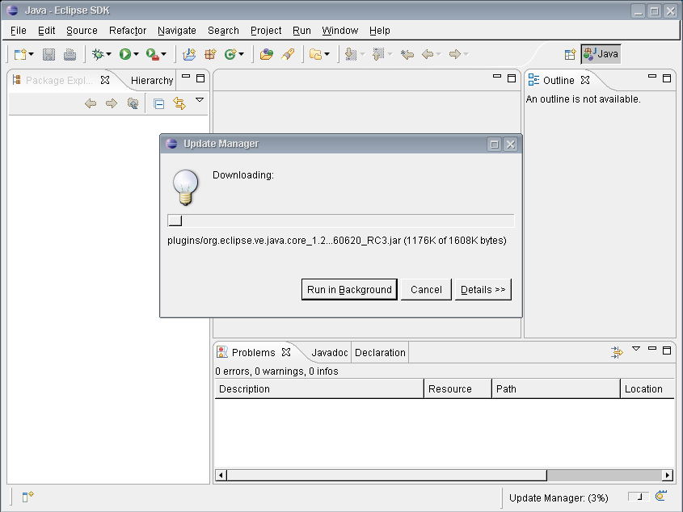
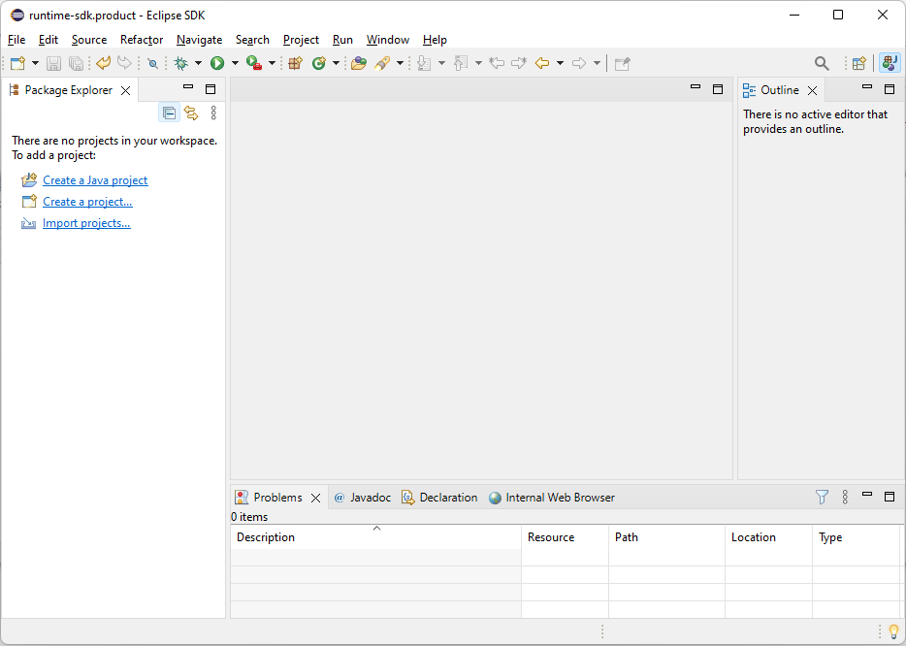
Eclipse Then and Now
2004
2024

Slide 4



SWT Modernization Goals / Constraints
Goals
  Modern Look & Feel
  (maybe “Eclipse look & feel”)
  Low(er) Maintenance Effort
  High Configurability
Constraints
  None/Low Effort for Adopters
  Cheap Technology Dependency
  (cost, maintenance, runtime)
  Capacities and Skillset for
  (Initial) Implementation Effort

Slide 5
Approaches
Range of Options with Key Properties
Replace completely with modern UI stack (e.g., web-based)
Replace with OS-agnostic graphics framework implementation
Amount of Replacement →
i.e., maintenance transfer to other technologies
From 3 to 1 SWT implementation
Update OS-specific implementations (e.g., WinUI 3, GTK 4)
Keep current OS-specific implementations

Slide 6





Benefits of OS-Agnostic Implementation
Modern Look & Feel
Eclipse Native Look & Feel
Enabler for improved configurability
(only single implementation of config option)
Reduced Maintenance Effort
Only one implementation of each change
Only one implementation / OS to test
Web Integration Enabler
If runnable via web assembly
Quick (ad-hoc) product/workspace setup
Web-based view/extension integration
Attractiveness
Modern technology more attractive for motivated/skilled people

Slide 7
What is Initiative 31?
The Goal

Slide 8
Project Goal
Develop a 4th Eclipse/SWT implementation
… that is …
OS-agnostic
compatible with the existing API
… in order to …
enable improved look & feel
improve customizability
reduce maintenance effort
(by finally deprecating/replacing
existing implementations)

Slide 9
Project Phases
Prototypes
Prototypes
Techn. 1
Techn. 2
Techn. 2
Techn. 3
Mature, Maintained
SWT Implementations
Techn. 2
Mature, Maintained
SWT Implementations
Mature, Maintained
SWT Implementations
Mature, Maintained
SWT Implementations
MacOS
MacOS
MacOS
MacOS
Windows
Windows
Windows
Windows
Mature, Maintained
SWT Implementations
Linux
Linux
Linux
Linux
Techn. 2
Current
Prototype
Realization
Production
Replacement

Slide 10
Prototype Phase: Goals
Key Questions
Is candidate technology X suited for the project’s goal?
  Is it capable of implementing everything that is provided by the union of the three existing SWT implementations?
  Does it provide better look & feel, lower maintenance and/or improved customizability?
Which of the suited technologies best fits for the project’s goal?

Slide 11



Prototype Phase: Technologies Selection
Preselection of technologies based on paper-based evaluation of criteria
Collection process:
  Systematic web search
  Wikipedia lists: Widget toolkits, Graphics libraries
Exclusion criteria:
  Non-cross-platform
  Web-based stacks
  Commercial license
  Low adoption
  Outdated
  Immature (most difficult to decide)
GTK
Swing
Skia with VCL
(from LibreOffice)

Slide 12
Prototype Phase: Process
Eclipse IDE WG On-Site
Consensus of WG companies concerning relevance of goals and commitment to invest
Kick-Off
Start of project with active contributions from Bosch/ETAS, Renesas, SAP, and Vector
Assignment
Assignment of developer capacities
to technologies:
GTK (Bosch/ETAS, Renesas),
Skia/VCL (SAP, Vector)
Swing (deferred)
Development
Ongoing Development of prototypes
Feb 27
May 17
May 24
Jul 10

Slide 13
Where is Initiative 31 now?
The State

Slide 14
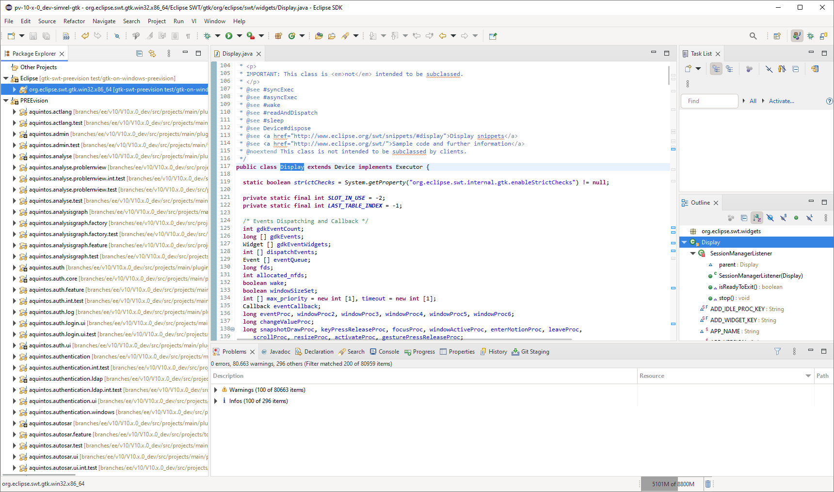
GTK: Technology Selection
Major Benefits:
SWT implementation exists → low-hanging fruit
Native customizing via CSS, themes available
GTK4 implementation required anyway
Ports
Windows
  GTK 3 and 4 available
  Maps to Win32 API
  Prototype available
MacOS
  GTK 3 and 4 available
  Uses Quartz backend
  (X Windows Server Port)
  Support improved with GTK 4
  Installable via homebrew

Slide 15
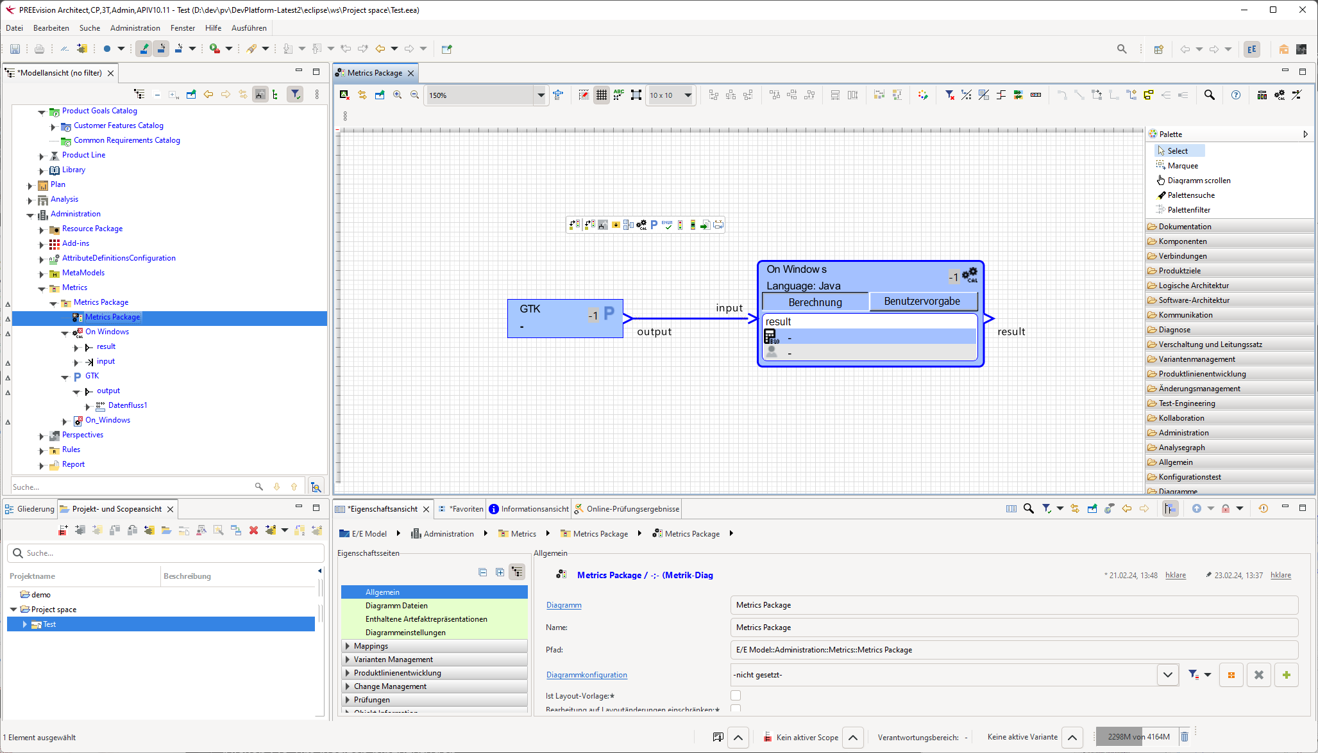
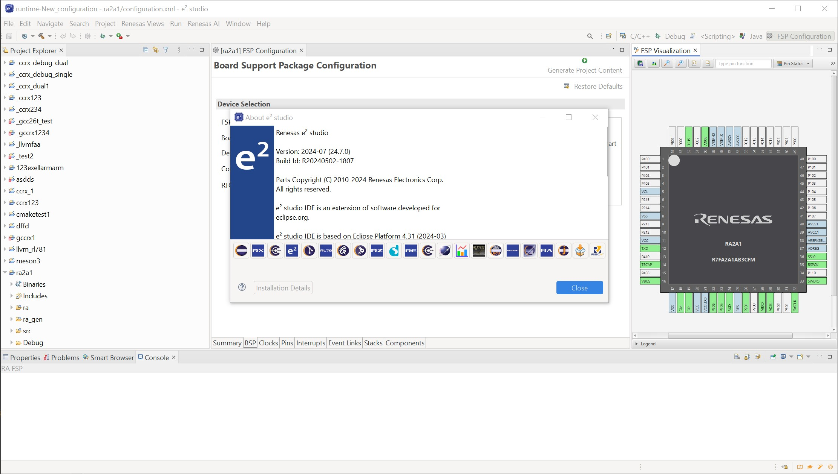
GTK: Current State
Working well on Windows with GTK3
(complete RCP platform)
Current issues
Compilation on MacOS
Compilation on Windows with GTK4
Printer support
No support for multiple displays
PREEvision (Vector)
e² Studio (Renesas)

Slide 16
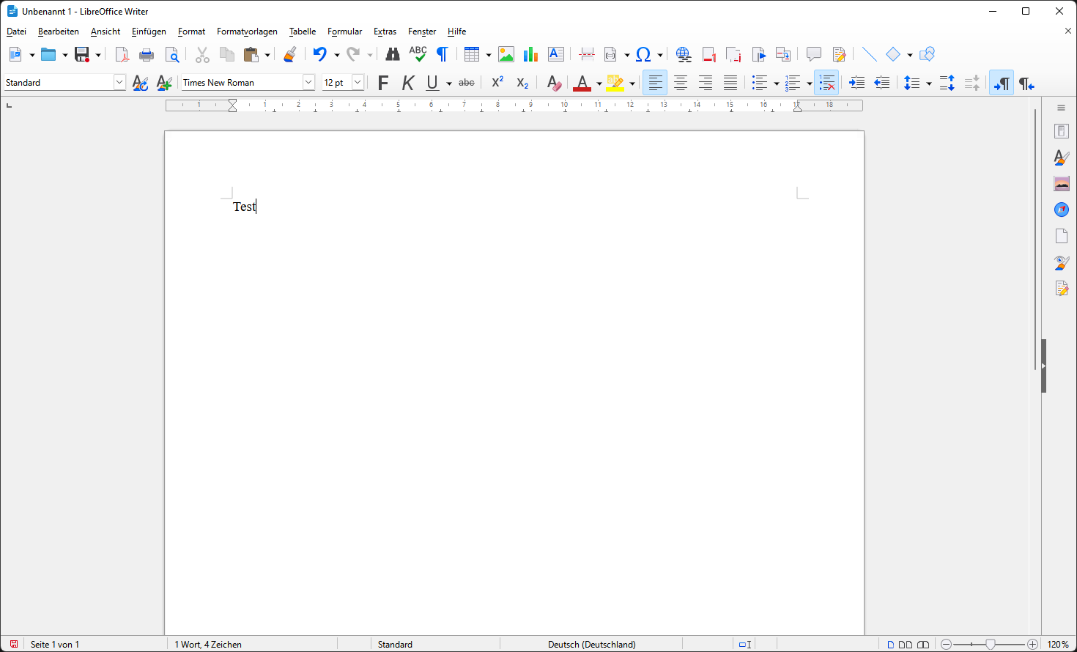
Skia/VCL: Technology Selection
Major Benefits
Fast, widely adopted graphics library
Enabler for WebAssembly deployment
Potential combination with other Skia-based products
Consider high update frequency
Widget Frameworks
Visual Component Library (VCL)
from LibreOffice
  Library is open source
  Shared efforts with LibreOffice
  Possibility of integration with LibreOffice
Alternative Candidate: Flutter
  Risk: young, fast evolving

Slide 17
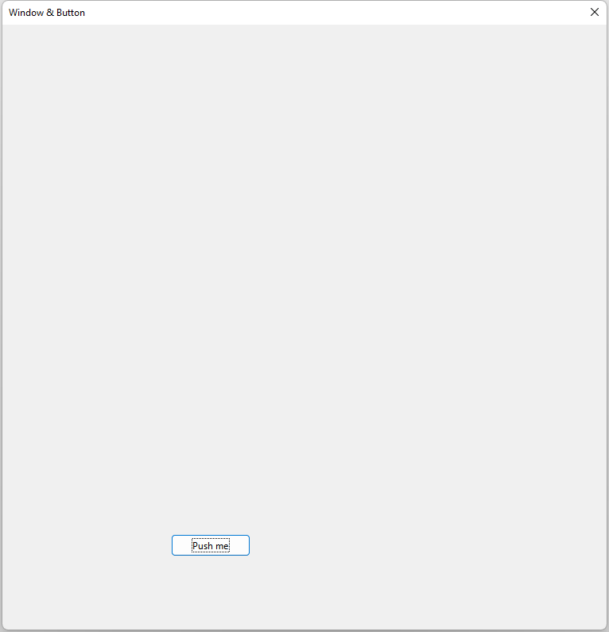
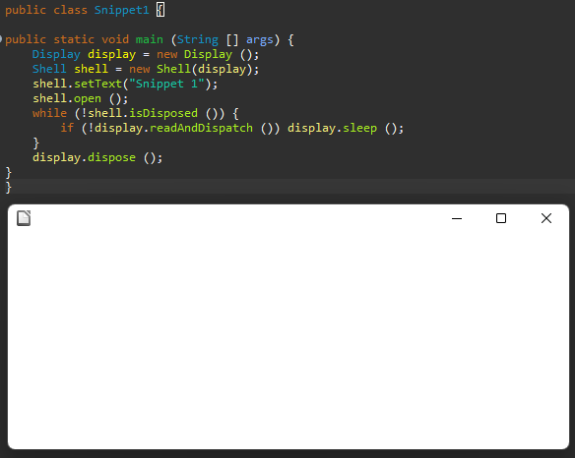
Skia/VCL: Current State
Frist VCL applications started from Java
Simple SWT snippet executed based on VCL
Difficult to extract VCL from LibreOffice
Identified Risks
Still unclear capabilities of VCL (and UNO API)
Potential adaptations to and modularization
of VCL may require
  (maintenance) capacity
  specific skillsets (C programming)
  willingness of LibreOffice to provide VCL as a module

Slide 18
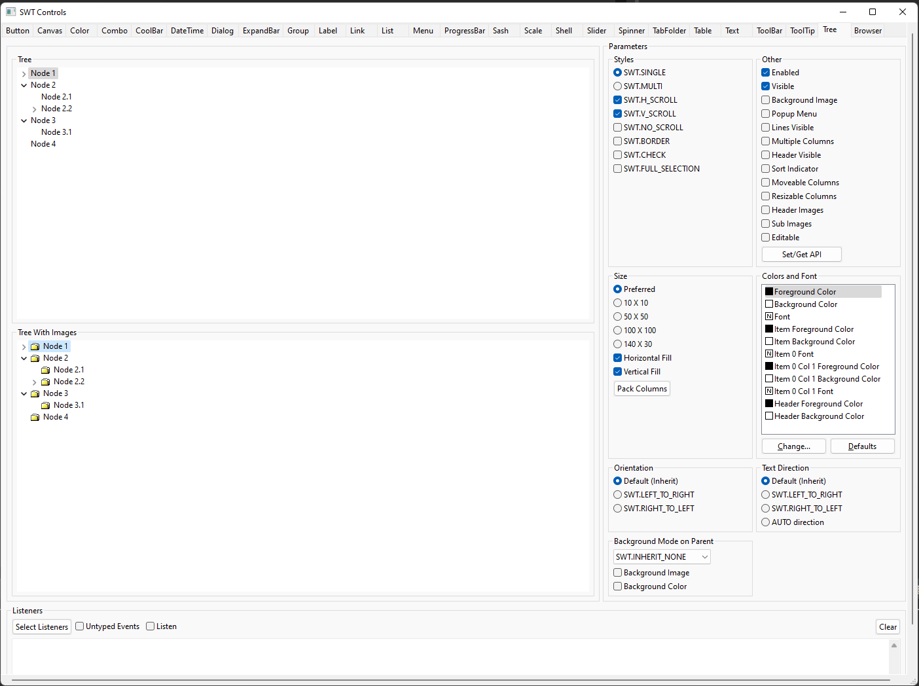
Skia/VCL: Outlook
Goals for prototype phase to
assess feasibility of a complete
SWT implementation:
Implement one widget completely
(as in SWT ControlExample)
Implement complex widget
(StyledText)

Slide 19
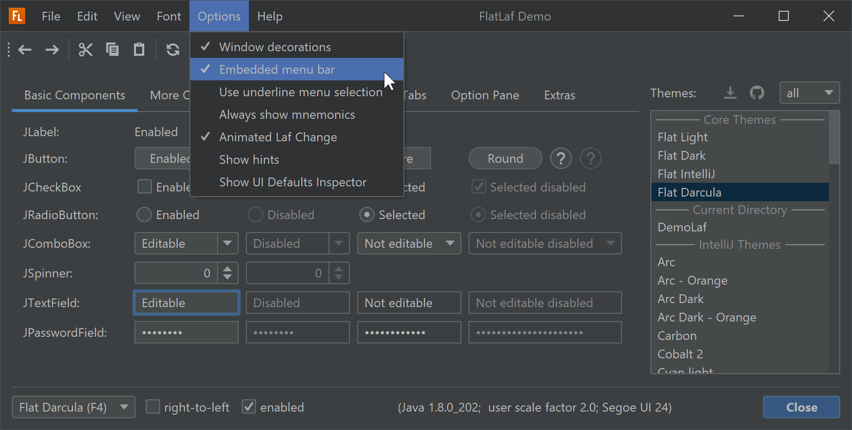
Swing: Technology Selection (currently not in work)
Major Benefits
Purely Java
  Java-native platform independence
  Easy deployment
  Developer availability
Used by IntelliJ / maintained by Oracle
Customizable look & feel, existing themes
Existing Prototype SWTSwing
Eclipse Issue Tracker, Eclipse Forum
Oracle Java Client Roadmap (2020)
”Swing and AWT: AWT has been an integral part of Java SE since its launch in 1995. Swing was introduced shortly thereafter as a separate library and finally incorporated into “J2SE 1.2” in 1998. Both toolkits are part of the Java SE Specification and core to many other toolkits and applications that build on top of them.
Oracle will continue developing Swing and AWT across all supported releases as a core Java SE technology.”

Slide 20
Approach Levels Revisited
Range of Options with Key Properties
Replace completely with modern UI stack (e.g., web-based)
Optimal Outcome
Replace with OS-agnostic graphics framework implementation
Amount of Replacement →
i.e., maintenance transfer to other technologies
From 3 to 1 SWT implementation
Update OS-specific implementations (e.g., WinUI 3)
Minimal Outcome
Keep current OS-specific implementations (+ GTK 4)

Slide 21
Summary
Outlook
Assessment of insights / results planned for ~ October:
Decision whether any of the technology options is worth to start a realization project
At least GTK 4 support needs to be addressed
Feedback
What is your impression?
What are your expectations?
What are your concerns?
Would you like to join?

Slide 22
Appendix
Collection of Additional Information

Slide 23
Why to Rethink the SWT Implementation
Outdated Look and Feel
Particularly on Windows (> 20-year-old API)
Different appearance on all OS (native)
Difficult / Expensive Maintenance
Technical debt
  Low code quality
  Lack of experienced developers
  Lack of people willing to learn
Complexity
  Everything must be implemented and validated for three OS
  OS-/version-specific tweaks
Limited Configurability
“Lowest common denominator” of OS APIs
Difficult to improve overall UI
Limited configurability / branding
Notes:
Mismatch between primarily Linux SWT developers and primarily Windows SWT users/adopters

Slide 24
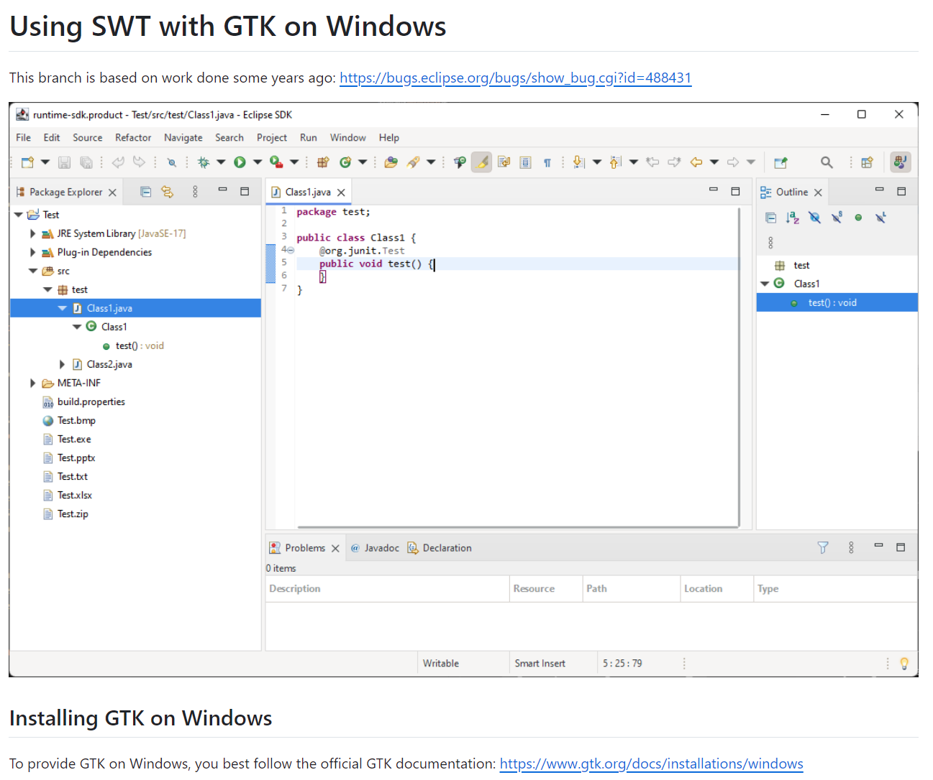
Prototype GTK on Windows: Try It Out!
Instructions:
https://github.com/HeikoKlare/eclipse.platform.swt/blob/gtk-on-windows/bundles/org.eclipse.swt/Readme.GTK.Win32.md
Code Branch:
https://github.com/HeikoKlare/eclipse.platform.swt/tree/gtk-on-windows

Slide 25
Target Technology Stack
App
Eclipse Applications, JFace, …
SWT
SWT API
OS-Agnostic SWT Graphics/Widgets
SWT Win Fragment
SWT Mac Fragment
SWT Linux Fragment
Lib
OS-Agnostic Graphics/Widgets Framework
OS
Win32 (OLE/COM/…)
MacOS Cocoa (Foundation/…)
POSIX (Glib/DBUS/IO/…)

Slide 26
Prototype Phase: Technologies
Technology | Properties
Skia (low-level graphics) with VCL / LibO widgets | Skia: widely and further adopted graphics library LibreOffice, Chrome, Firefox, WebKitGTK, Uno Platform, … Widget framework options: Visual Class Library (VCL) by LibreOffice Flutter (quite young, fast evolving) Maybe easy integration with other Skia-based tools
GTK (widget framework) | Available for all major OS (ports for Windows and MacOS) Low risk as SWT implementation already exists (GTK 3) Prototype with SWT fragment combining GTK and Win32 exists
Swing (widget framework) | Purely Java (easy deployment, Java-native platform independence, developer availability, …) Supported by Oracle and used by JetBrains (IntelliJ) Good customizability (HiDPI, vectorized icons etc.) Prototype “SWTSwing” was already under development

Slide 27
Prototype Phase: Criteria
Functionality
Java bindings / usable from Java
Integration of browser (possible)
Can fulfill existing API
(even OS-specific one):
  Support for multiple Display instances
  (exists for Windows)
  Embedding of native window handles
  Embedding of AWT/Swing widgets
Optional: Executable in browser (WebAssembly)
Quality
Open source, compatible license
Actively maintained, widely adopted
Mature at least on Win, Linux, Mac
Critical / Difficult Points
Integration of SWT event loop
Uncommon object hierarchy direction
Custom widgets impact (e.g., Nebula)
TextLayout / StyledText (highest complexity)

Slide 28
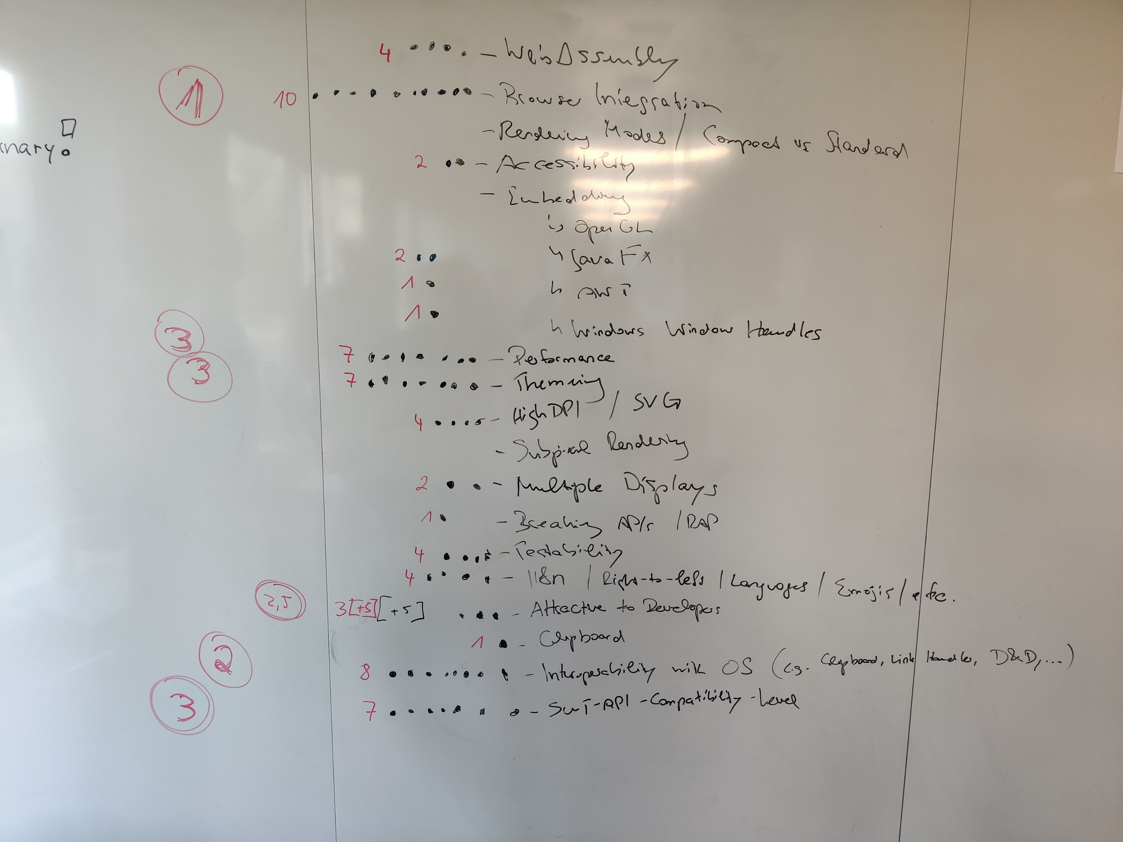
Criteria Collected at IDE WG Meeting
Eclipse IDE WG meeting 27th Feb 2024
Collection Process
Brainstorming of criteria
5 dots per participant for rating
criteria of highest importance
Numbers in circles indicate priority order resulting from dots
Remarks
List may be incomplete
List combines …
  Features that must just be implemented
  Features that must be provided or
  enabled by the technology
↑ these must be evaluated in prototypes

Slide 29
Technologies: Exclusion List
  Specific Candidates
  QT
    Widely adopted, but risk of release again only under commercial license
  Fyne
      Modern, but not yet mature
      Only adopted by FyneDesk (linux desktop)
  Flutter
      Rather new and particularly for responsive, also mobile applications
  Abstract Window Toolkit (AWT)
      Uses native widgets → platform-dependent
      Primitive and less flexible compared to Swing
  wxWidgets
      Abstraction for native APIs, just like SWT Several tools, but not really widely adopted
      Java bindings outdated (2013)
Outdated
  CEGUI
  FOX toolkit
  XForm
  XVT
  Clutter
  JavaFX
Low Adoption
  Elementary
  IUP
  Tk
  FLTK
  Juce (commercial license)
  U++

Slide 30
Additional Information
WebAssembly (from Manuel Bork)
CheerpJ: Java WASM on HTML, but proprietary, used more commonly for interacting with legacy Java 8 code from modern web frameworks
Perhaps WASM is not even the right direction. This is a good paper on comparing WASM JVM solutions
Learnings from other tools
Chrome, Firefox, LibreOffice use Skia (LibreOffice migrated from Cairo)
IntelliJ Fleet uses Noria (reactive framework like React or SwiftUI) on Skia
IntelliJ IDEA:
UI refresh in 2022, still based on customized Swing (now looking like VSCode), but mainly pure Swing components
NetBeans uses Swing

Slide 31
Increments Proposal: GTK 3/4
GTK 3 steps completely parallelizable
GTK 3
Make MacOS port run SDK
Enable support for multiple SWT Display instances
Embed native window handles
Make SDK run without any tweaks in SWT code
Make SDK run without any exclusions in native code
GTK 4
Make SWT ControlExample run on Linux
Make SWT CustomControlExample run on Linux
Make SDK working on Linux
Make SDK work on Windows and MacOS
Identify further tasks for GTK 4 implementation

Slide 32
Increments Proposal: Swing
Make SWT Snippet1 (show Window) run
Make SWT Snippet116 (Textbox + Button) run
Create demonstrator with multiple SWT Display instances
Embed native window handles
Embed demo browser

Slide 33
Increments Proposal: Skia/VCL
Set up Skia (+ Skija) with some demo project
Set up Skia with minimal VCL example (from LibreOffice)
Make SWT Snippet1 (show Window) run
Make SWT Snippet116 (Textbox + Button) run
Create demonstrator with multiple SWT Display instances
Embed native window handles
Embed demo browser
In parallel after step 4: Make work on second operating system
Can be started after 3.

